Slide 1
Discrete Mathematics
Nondeterministic and Deterministic Finite Automata & Regular Grammars
Week 10
Ida Bagus Kerthyayana Manuaba
imanuaba@binus.edu

Slide 2
Session Learning Outcomes
Upon completion of this session, students are expected to be able to
define basic discrete structures and its properties including: logic proposition, sets, finite automata, grammars, and matrix.
define the notion of mathematical thinking, mathematical proofs, and recursion.

Slide 3
Nondeterministic and Deterministic Finite Automata & Regular Grammars

Slide 4
Nondeterministic and Deterministic Finite Automata & Regular Grammars
Generators
    Grammars
      Context-free
      Regular
    Regular Expressions
Recognizers
    Parsers, Push-down Automata
      Context Free Grammar
    Finite State Automata
      Regular Grammar
A Finite Automata is:
  a mechanism to recognize a set of valid inputs before carrying out an action.
  a notation for describing a family of language recognition algorithms.

Slide 5

Operation of the machine
0
0
1
Input Tape
Tape Head
Finite Control
Read the current letter of input under the tape head.
Transit to a new state depending on the current input and the current state, as dictated by the transition function.
Halt after consuming the entire input.

Slide 6

Operation of the machine
Transitions show the initial state, input, and next state
  Form: δ(q,a)=b
Example:
  δ(q₀,0)=q₁ δ(q₀,1)=q₂
Tape head advances to next cell, in state q₁
What happens now?
  What is δ(q₁,0)?
0
0
1

Slide 7
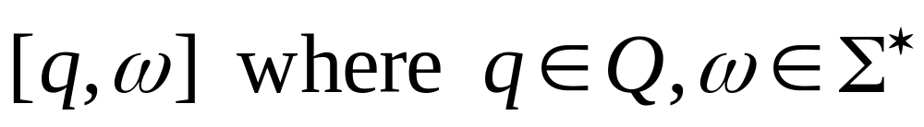
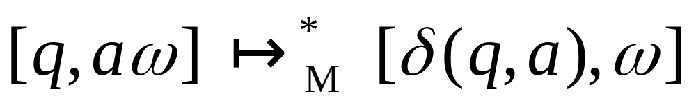
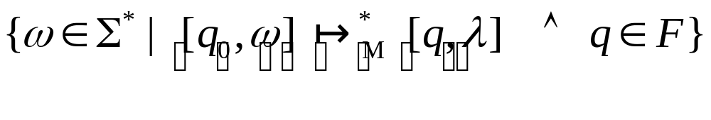
Associating Language with the DFA
Machine configuration:
Yields relation:
Language:

Slide 8
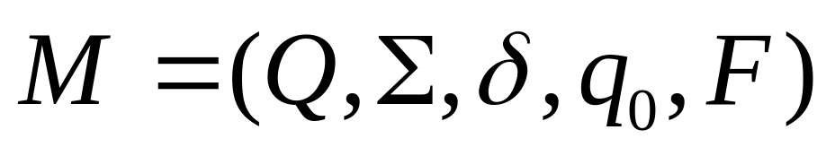

Deterministic Finite Automaton (DFA)
    Q:Finite set of states
    Σ: Finite Alphabet
    δ: Transition function
    - a total function from QxΣ to Q
    :Initial/Start State
    F :Set of final/accepting state

Slide 9
Finite State Diagram
A graphic representation of a finite automaton
A finite state diagram is a directed graph, where nodes represent elements in Q (i.e., states) and arrows are characters in Σ such that:
q_{a}
a
q_{b}
Indicates:
((q_{a},a),q_{b}) is a transition in δ
The initial state is marked with:
>
The final state(s) are marked with:

Slide 10
Automata
Deterministic automata – each move is uniquely determined by the current configuration
  Single path
Nondeterministic automata – multiple moves possible
  Can’t determine next move accurately
  May have multiple next moves or paths

Slide 11
Automata
An automaton whose output response is limited to yes or no is an acceptor
  Accepts input string and either accepts or rejects it
Measures of complexity
  Running time
  Amount of memory used

Slide 12
Automata
Finite automaton
  Uses a limited, constant amount of memory
  Easy to model
  Limited application

Slide 13
Automata
Given an automaton A = (Q,Σ,δ,q₀,F), and a string w ∈ Σ*:
w is accepted by A if the configuration (q₀,w) yields the configuration (F, ∈), where F is an accepting state
the language accepted by A, written L(A), is defined by:
L(A) = {w ∈ Σ* : w is accepted by A}

Slide 14
Automata
Deterministic finite automaton
  Every move is completely determined by the input and its current state
  Finite control device
    Can be in any one of the states, q ∈ Q
  May contain trap or dead states
  Contains accepting state(s)

Slide 15
Examples
Deterministic

Slide 16
Language Acceptor
Design a FSA to accept strings of a language
  strings of a’s and b’s that start and end with a
Q: States are required for the following:
  q₀: Start state
  q_{t}: Trap for strings that start with a b
    Accepting state can’t be reached
      Machine only accepts strings that start with an a
  q_{f} : State reached after any a in a string that started with an a
    The final state
  q₁: State reached after any b in a string that started with an a

Slide 17
Language Acceptor
Σ : {a,b}
δ : δ(q₀ , a) = q_{f} Is the string a in the language?
δ(q₀ , b) = q_{t}
δ(q_{t} , a) = q_{t} δ(q_{t} , b) = q_{t}
δ(q_{f} , a) = q_{f} δ(q_{f} , b) = q₁ δ(q₁ , a) = q_{f} δ(q₁ , b) = q₁

Slide 18
Language Acceptor
q₀
a
q_{f}
b
q₁
a
a
b
b
q_{t}
a,b

Slide 19
Vending Machine
Suppose:
  All items cost 40¢
  Coins accepted are 5¢, 10¢, 25¢
  Recall
  What are these entities?
  Q is a set of states
    What are the possible states?
  Σ is the alphabet
    What are the input symbols?
  δ are the transitions
    How do we move from state to state?
  q₀ is the starting state
    Where does the machine start from?
  F is the final state
    When does the machine stop?

Slide 20
Vending Machine
Q: What are the possible states?
  The status of the machine before and after any of the alphabet symbols have been applied
    The present state represents how much money has been deposited
    Could also represent how much is left to deposit
Σ: What are the input symbols?
  The coin denominations
δ: How do we move from state to state?
  Transition when a coin is deposited
q_{0:} Where does the machine start from?
  The beginning!
F is the final state
  When does the machine stop?
    Not before you’ve deposited enough money
Wait! What if you put in more than 40¢?

Slide 21
Set of strings over {a,b} that contain bb
Design states by parititioning Σ*.
  Strings containing bb q2
  Strings not containing bb
    Strings that end in b q1
    Strings that do not end in b q0
  Initial state: q0
  Final state: q2

Slide 22
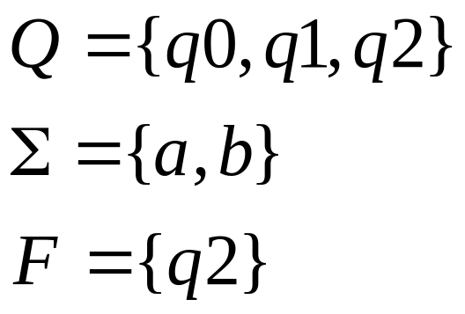
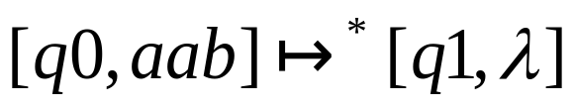
State Diagram and Table
b
a
a
q0
q1
b
q2
b
a
δ | a | b
q0 | q0 | q1
q1 | q0 | q2
q2 | q2 | q2

Slide 23
Strings over {a,b} containing even number of a’s and odd number of b’s.
b
[Ea,Eb]
[Ea,Ob]
b
a
a
a
a
b
[Oa,Eb]
[Oa,Ob]
b

Slide 24
Non-Determinism

Slide 25

Automata
Non-deterministic finite automaton
  More than one destination from a state with a distinct input
  At least one state has transitions that cannot be completely determined by the input and its current state
  It is possible to design a machine where a single input can have two paths to an accepting state
  transitions
    Move from a state without input

Slide 26
NDFA
Nondeterministic finite automata
  Quintuple A = (Q,Σ, Δ, s, F) where
    Q is a finite set of states
    Σ Is an input alphabet
    Δ ⊆ Q x (Σ ∪ { }) x Q is the transition relation
    S ∈ Q is the initial state of the automaton
    F ⊆ Q is the set of favorable states

Slide 27
NDFA
The range of Δ is not a single element of q, but a subset of q
  Example: Δ (q1,a) = {q0,q2}
    Either q0 or q2 could be resultant state
Empty string (null input) can result in a change of state

Slide 28
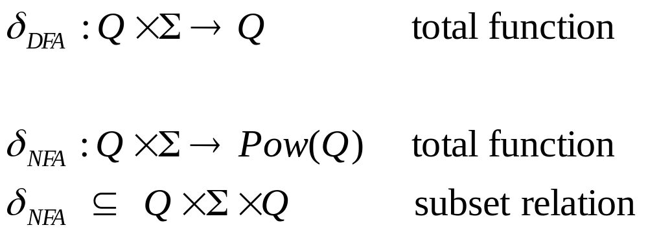
NFA
a
a
q_{i}
q_{j}
q_{i}
q_{j}
a
DFA
q
a
q_{k}
NFA

Slide 29
NDFA
Stuck state – no jumps out of state labeled with the input symbol
  Can not lead to accepting state
  Removes need for trap state
Input is accepted if any resultant configurations lead to an accepting state

Slide 30
NDFA
Given an NFA A = (Q,Σ,Δ,q₀,F), and a string w∈Σ*:
  w is accepted by A if at least one of the configurations yielded by (q₀,w) is a configuration of the form (F,ε) with f a favorable state
  L(A) = {w ∈ Σ* : w is accepted by A}

Slide 31
Examples
Non-Deterministic

Slide 32
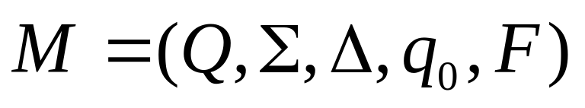
Language Acceptor (Revisited)
Design a FSA to accept strings of a language
  strings of a’s and b’s that start and end with a
Only change is in δ morphing to Δ
Some transitions eliminated

Slide 33
Language Acceptor
q₀
a
q_{f}
b
q₁
a
a
b
b
q_{t}
a,b

Slide 34
Another Language Acceptor
Build a FA to accept strings of even length
Wait! This only accepts strings of length 2
How to update?
q₀
a,b
q₁
a,b
q₂

Slide 35

Another Language Acceptor
As a DFA? (What’s wrong here?)
As an NFA (use transitions)
q₀
a,b
q₁
a,b
q₂
a,b
q₀
a,b
q₁
a,b
q₂

